Slide 1
Project Member: 1. Mohammad Bin Khasru ( ) 2.Rafid Hassan( ) 3.Khadizatul Kubra ( 1620070042)
Cse 299 Presentation on
Arduino Based Obstacle Detecting Car with Radar and Fire extinguish system

Slide 2
Motivation:
Now day’s many industries are using robots due to their high level of performance and reliability and which is a great help for human beings. The obstacle avoidance car is used for detecting obstacles and avoiding the collision. This is an autonomous robot. The design of obstacle avoidance robot requires the integration of many sensors according to their task.
The obstacle detection and radar are the primary requirement of this autonomous car. The car gets the information from surrounding area through mounted sensors on the car. Some sensing devices used for obstacle detection like bump sensor, infrared sensor, ultrasonic sensor etc. Ultrasonic sensor is most suitable for obstacle detection and it is of low cost and has high ranging capability.

Slide 3
Things we have learnt:

Slide 4
Key Elements:
Arduino Uno
Ultrasonic Sensor
Battery
DC Motor
Motor Driver
Platform we’re Using:

Slide 5
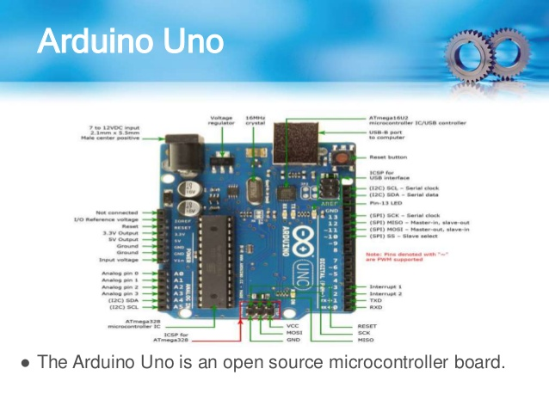
Arduino Uno:

Slide 6
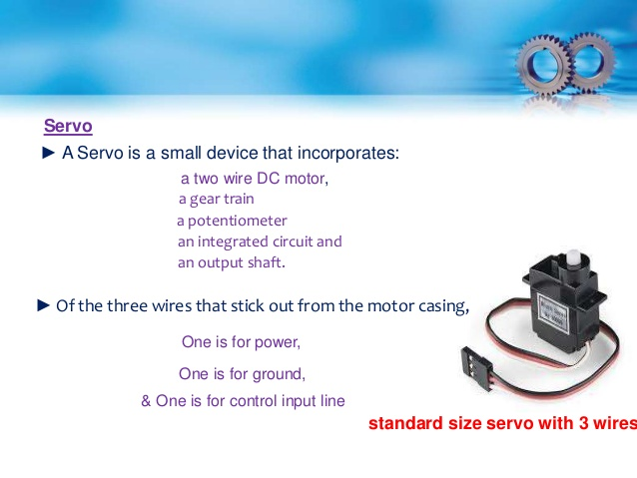

Slide 7
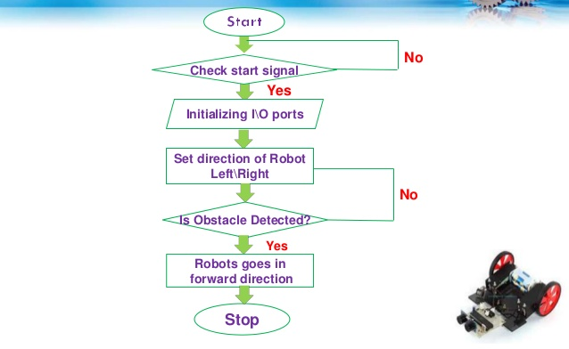
Flow Chart:

Slide 8
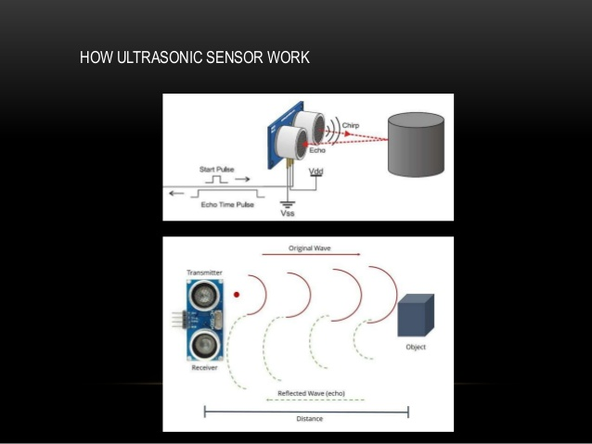
How Ultrasonic Sensor Work:

Slide 9
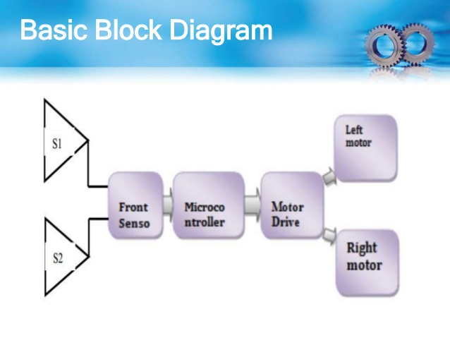
Basic Block Diagram:

Slide 10
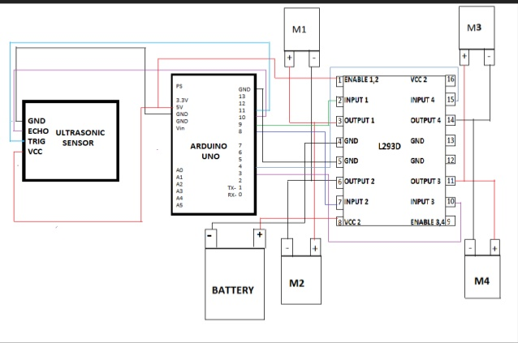
Circuit Diagram

Slide 11
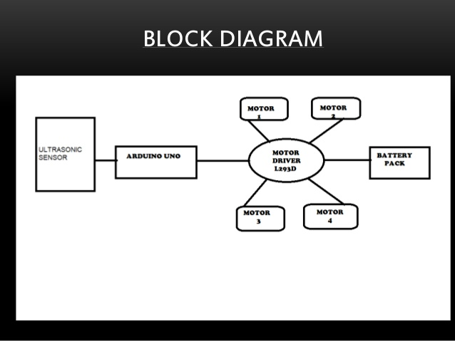
Block Diagram:

Slide 12
Working:
The Obstacle Avoidance vehicle uses Ultrasonic Sensor for its movements. Arduino is used to archieve the desired operation.
The motors are connected through motor driver IC to Arduino. The ultrasonic sensor is attached in front of the robot.
Whenever the robot is going on the desired path the ultrasonic sensor transmits the ultrasonic waves continuously from its sensor head.
Whenever an obstacle comes ahead of it the ultrasonic waves are reflected back from an object and that information is passed to the Arduino Uno.
The radar will give the Graphical View of the object.

Slide 13
The Arduino controls the motors left, right, back, front, based on Ultrasonic signals.
When the ultrasonic Sensor detect the object which is kept inside the path it will send signal toward the arduino uno and according to that it will rotate the motor.
Similarly in every time whenever an obstacle in founf to be in path of car it will detect it and rotate the car in left direction to avoid the obstacle.

Slide 14
Advantages:
It can be used as a Movable Surveillance System.
It can be controlled remotely.
It does not require any man power.
It can be used fro critical application like flood, bomb disposal, fire, terrorist attack, Earth quake and spying.
Driverless vehicles running alone
In wheel chair for patients.
Autonomous cleaning robot.

Slide 15
Implementation:
Final Result:

Slide 16
Code:

Slide 17
Refernces:

